Slide 1
Gas Station Simulator

Slide 2
Agenda
01
02
03
04
About our Team
Our Project
Who we are?
What we do?
ShowCase
Summarize
What is that?
What do we get?

Slide 3
01
Our Team

Slide 4

Who we are?
Ke Jia:
The big boss guiding the team.
RunZhou Zhu:
A committed and tireless worker.
QingYun Wang:
The fresh face driving new ideas.
Yang Yang:
The reliable force that keeps the team together.

Slide 5
02 Our Project
What we do?

Slide 6
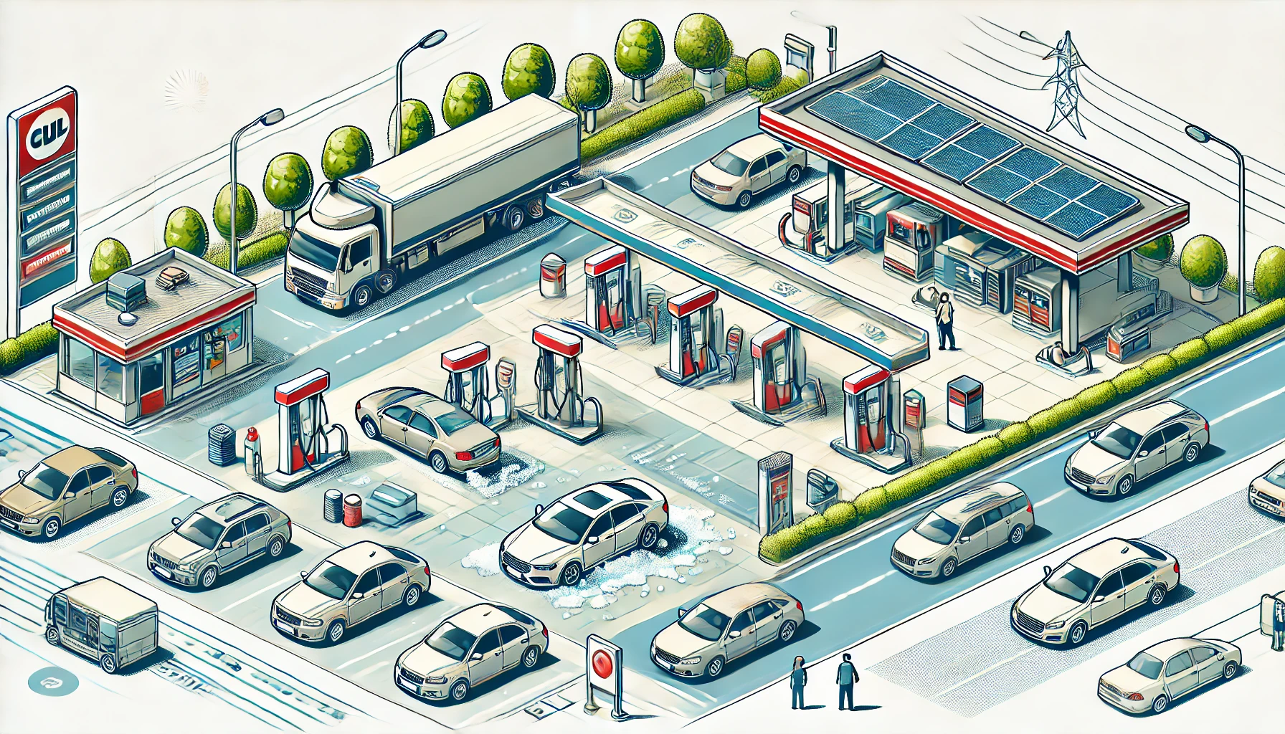
What we want to do？

Slide 7
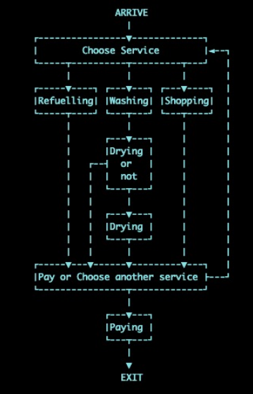
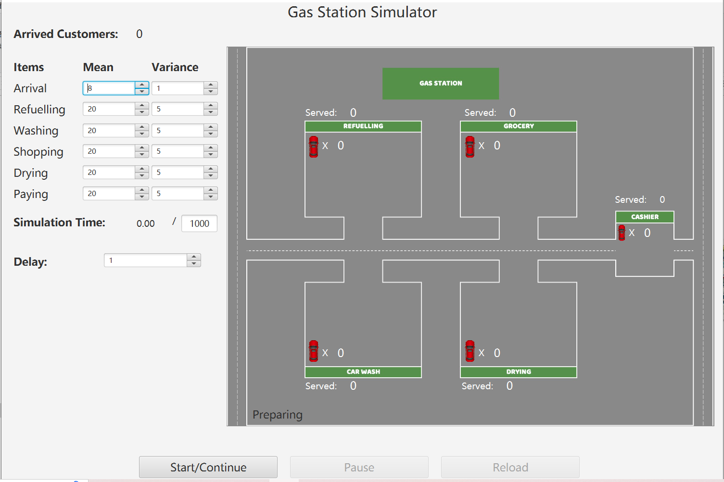
In fact, What we do~~~

Slide 8
03 Show Case

Slide 9
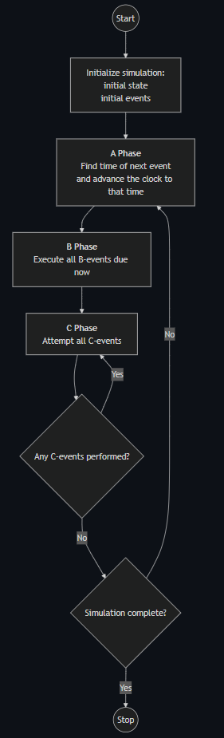
Three Phase Simulation
Find time and generate next event
Decide where customer will go
A-phase
B-phase
C-phase
Run events in event list.

Slide 10
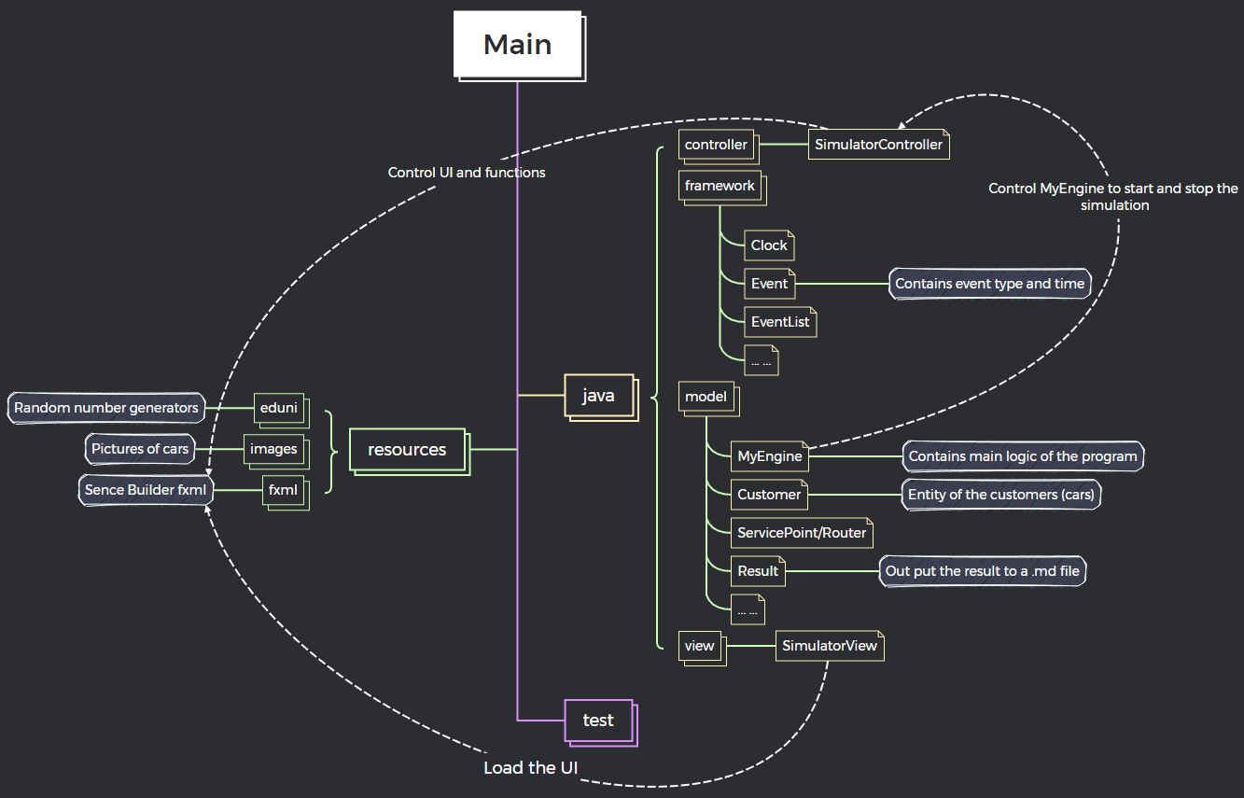
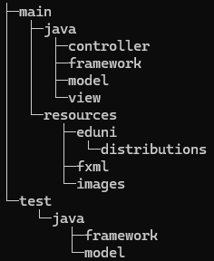
Project Structure
File struture:

Slide 11

04 Summarize

Slide 12
Thanks!
Do you have any questions?

